Slide 1
EUROPEAN AIRSPACE COMPLEXITY AND
FRAGMENTATION CORRELATION RESEARCH
Research workshop: Fragmentation in Air Traffic and its Impact on ATM Performance
14 - 15 May 2019, Budapest, Hungary
Zvonimir Rezo, PhD student Sanja Steiner, PhD
E-mail: zvonimir.rezo@gmail.com E-mail: ssteiner@hazu.hr
Corresponding author
Croatian Academy of Sciences and Arts
Traffic Institute, Kušlanova 2, 10000 Zagreb, Croatia

Slide 2
PRESENTATION CONTENT
Problem Definition & Research Questions;
Airspace Complexity Assessment;
Airspace Fragmentation Assessment;
Research Findings & Discussion;
Conclusions.

Slide 3
Problem Definition & Research Questions:
Airspace complexity and fragmentation correlation
Where are located spatial clusters?
How intense is the clustering?
Where are located hotspots?
What is the current European airspace fragmentation status in dependence of commonly accepted and measured airspace complexity indicators?
Which features are most alike?
Do spatial performances differ?
How big and homogenous are spatial patterns?

Slide 4
EUROPEAN AIRSPACE COMPLEXITY ASSESSMENT METHODOLOGY
ACE Working Group on Complexity. Complexity Metrics for ANSP Benchmarking Analysis. EUROCONTROL, Brussels, 2006
Used parameters & indicators:
Interaction counting
Flight hours
Adjusted density Complexity score
Vertical Different Interacting Flows
Horizontal Different Interacting Flows Structural index
Speed Different Interacting Flows

Slide 5
Figure 1 - 4D cell dimensions
EUROPEAN AIRSPACE COMPLEXITY ASSESSMENT METHODOLOGY
dz = 3000 [ft]
dt = 60 [minutes]
dy = 20 [NM]
dx = 20 [NM]

Slide 6
EUROPEAN AIRSPACE FRAGMENTATION ASSESSMENT METHODOLOGY
Spatial autocorrelation
Complexity score value Spatial distribution
Tobler's first law of geography
“Everything is related to everything else, but near things are more related than distant things”
Used indicators:
Local Indicator of Spatial autocorrelation (LISA)
Global Indicator of Spatial autocorrelation (GISA)
Clustering significance testing

Slide 7
EUROPEAN AIRSPACE FRAGMENTATION ASSESSMENT METHODOLOGY
Local Indicator of Spatial autocorrelation (LISA)
Concept design
close neighborhood analysis
more accurate than GISA
Application overview:
LISA analysed whether the observed value at AoR (i) is independent of neighbouring localities AoRs (j) by taking into account sample mean (x̄), number of AoRs (n) and the spatial weight (w_{ij}) of the connection between area AoR (i) and AoRs (j).

Slide 8
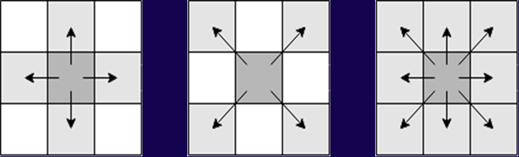

EUROPEAN AIRSPACE FRAGMENTATION ASSESSMENT METHODOLOGY
Local Indicator of Spatial autocorrelation (LISA)
Modeling approach
$$I_{i}=\frac{\left(x_{i}− \overline{x}\right)\sum_{j=1}^{n}{w_{ij} (x_{j}− \overline{x})}}{\sum_{j=1}^{n}{{(x_{j}− \overline{x})}^{2}/n}}$$
Rook Bishop Queen
Figure 3 - Contiguous spatial weights matrices

Slide 9
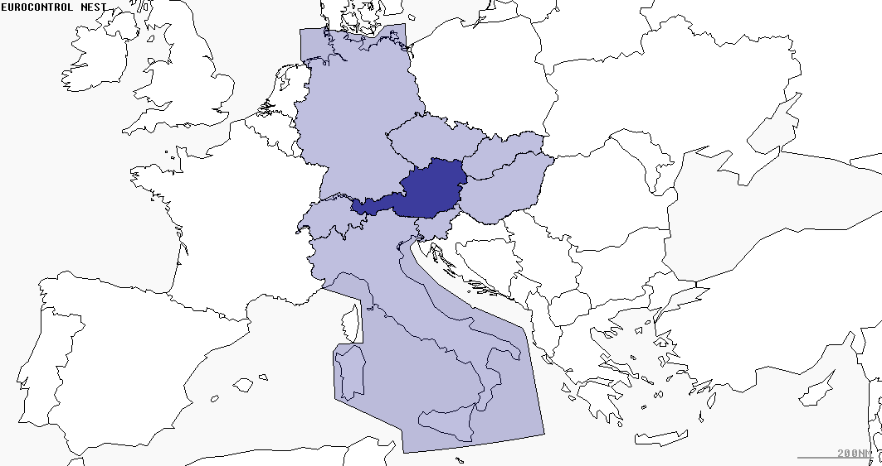
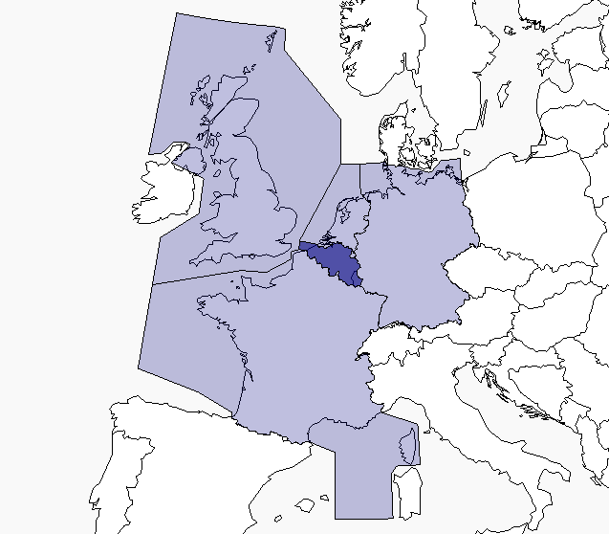
EUROPEAN AIRSPACE FRAGMENTATION ASSESSMENT METHODOLOGY
Local Indicator of Spatial autocorrelation (LISA)
(a) Austro Control [80,900 km²] (b) Skyeyes [39,500 km²]
Figure 4 - Queen weights matrix application examples

Slide 10
EUROPEAN AIRSPACE FRAGMENTATION ASSESSMENT METHODOLOGY
Global Indicator of Spatial autocorrelation (GISA)
Concept design
Application overview:
It detects spatial patterns across the entire area of interest whereby it does not reveal where significant patterns appear. It is analogous to Pearson's correlation coefficient ranging from -1 to +1 where:
  -1 indicates strong negative autocorrelation,
  0 denotes completely random values allocation,
  +1 signifies strong spatial autocorrelation.

Slide 11
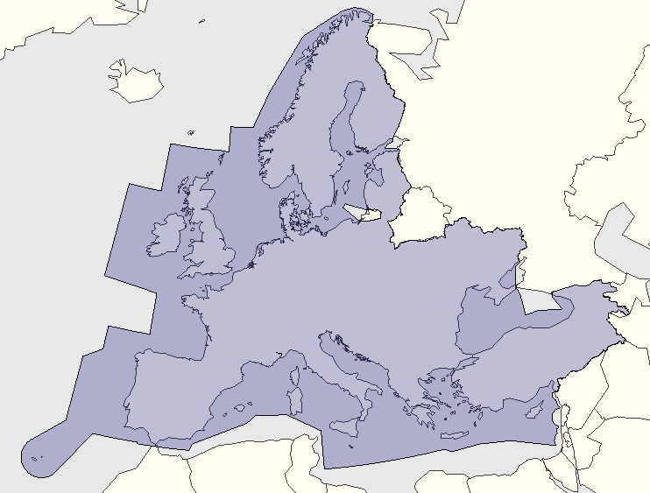

EUROPEAN AIRSPACE FRAGMENTATION ASSESSMENT METHODOLOGY
Global Indicator of Spatial autocorrelation (GISA)
Modeling approach
$$I=\frac{1}{n}\sum_{i=1}^{n}{I_{i}}$$
n = 37 AoRs/ANSPs
Area: 11,203,200 km²
Figure 5 – Spatial overview of researched area

Slide 12
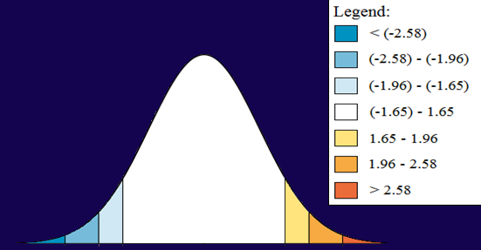
EUROPEAN AIRSPACE FRAGMENTATION ASSESSMENT METHODOLOGY
Clustering significance test
Concept design
Statistical significance Probability test
(z-score) (p-value)
Figure 6 - Clustering significance testing
Significant
Random

Slide 13
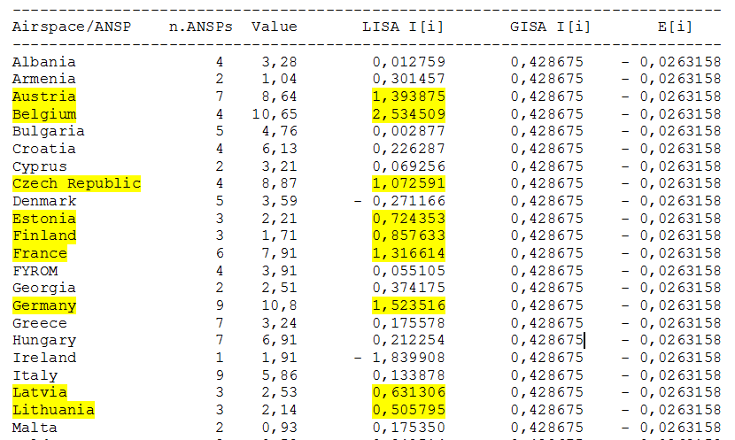
RESEARCH FINDINGS & DISCUSSION
Figure 7 – Tabular display of research results

Slide 14
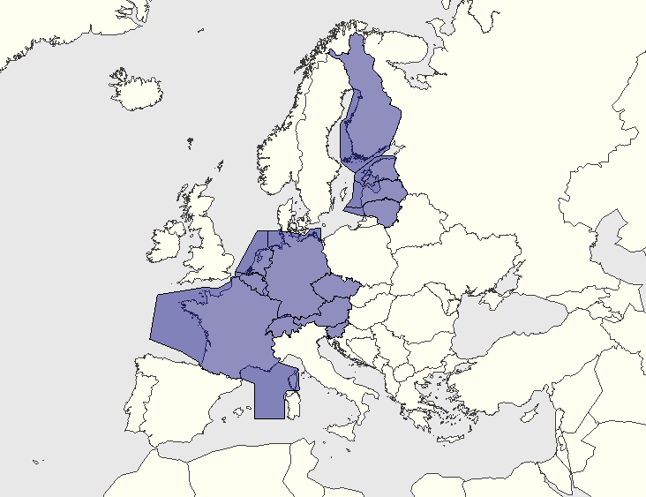
RESEARCH FINDINGS & DISCUSSION
Figure 8 – Spatial overview of research results

Slide 15
RESEARCH FINDINGS & DISCUSSION

Slide 16
RESEARCH FINDINGS & DISCUSSION
Clustering significance testing results
Null hypothesis testing
“There is no spatial clustering of the values associated with the geographic features in the study area”
z-score: 0.581788 Null hypothesis can’t be rejected
p-value: 0.2810 Result of random spatial processes

Slide 17
RESEARCH FINDINGS & DISCUSSION
Clustering significance testing results
Figure 10 – Critical values results distribution share

Slide 18
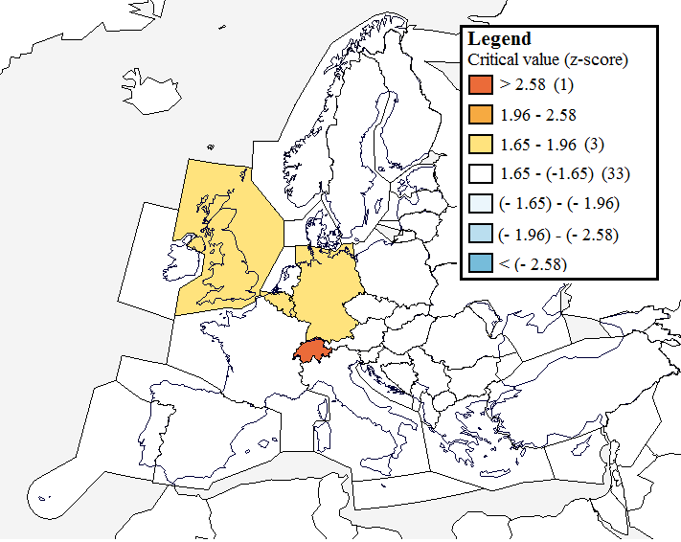
RESEARCH FINDINGS & DISCUSSION
Clustering significance testing results
Figure 11 – Spatial overview of critical values results

Slide 19
CONCLUSIONS
Two areas were identified as areas which spatially associate adjacent AoRs. (Figure 8)
European airspace is fragmented into different homogeneous and sized spatial patterns. (Figure 9)
Pattern of spatial distribution is random and clusters do not exist. (p.16 & Figure 10)
Switzerland, i.e. Skyguide's AoR with the highest deviate value represent a hotspot (Figure 11)
Q&A
Thank you for your attention!

Slide 20
EUROPEAN AIRSPACE COMPLEXITY AND
FRAGMENTATION CORRELATION RESEARCH
Research workshop: Fragmentation in Air Traffic and its Impact on ATM Performance
14 - 15 May 2019, Budapest, Hungary
Zvonimir Rezo, PhD student Sanja Steiner, PhD
E-mail: zvonimir.rezo@gmail.com E-mail: ssteiner@hazu.hr
Corresponding author
Croatian Academy of Sciences and Arts
Traffic Institute, Kušlanova 2, 10000 Zagreb, Croatia

